Slide 1
www.innovacommunications.com

Slide 2
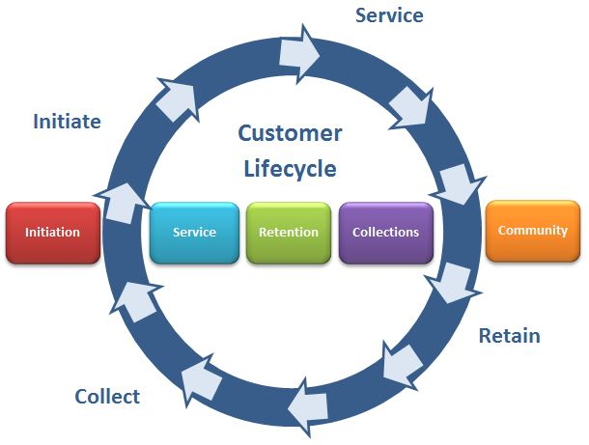
About INNOVA
INNOVA Communications is a Customer Life Cycle Management Services organization based out of Noida. We as an organization are focused on delivering superior customer experience both for our outsourcing principal partner organizations and the end users of their products and services.
We believe in creating value through innovation in use of technology platforms & people/Process management to deliver a superior customer experience. We have a strong focus on value added services like field collections & verification / lead generation / customer care & Ticket Closing / closed looping services.
.
Working on industry standard process management tools and infrastructure enables us to seamlessly integrate with our client systems. We have been able to create a “valued partner” positioning with a strong focus on professionalism, Transparency and SLS management.
Used a phased approach towards process Standardization and Optimization we deliver a seamless, scalable and secure technology driven solution.
.
www.innovacommunications.com

Slide 3
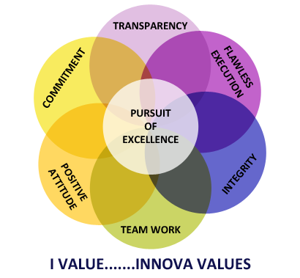
“Market Leadership” through our value system
www.innovacommunications.com

Slide 4
INNOVA Group
www.innovacommunications.com
Notes:
At its core, New Ways of Working is all about organizing work for better productivity and making conscious choices and better decisions about the culture and technology we surround ourselves with at Work. These, in turn, lead to greater worker engagement and more fulfillment in our jobs. Why? We spend the majority of our waking hours each day on the job, so why shouldn’t work be enjoyable? Equally important, it’s critical that our organizations be successful. We know that greater employee engagement leads to higher job satisfaction, which results in improved productivity and greater company success.

Slide 5
INNOVA Group
Group Turn Over : INR 160 Cr
Team Strength : 626
Locations : 11 Across India
www.innovacommunications.com
Notes:
At its core, New Ways of Working is all about organizing work for better productivity and making conscious choices and better decisions about the culture and technology we surround ourselves with at Work. These, in turn, lead to greater worker engagement and more fulfillment in our jobs. Why? We spend the majority of our waking hours each day on the job, so why shouldn’t work be enjoyable? Equally important, it’s critical that our organizations be successful. We know that greater employee engagement leads to higher job satisfaction, which results in improved productivity and greater company success.

Slide 6
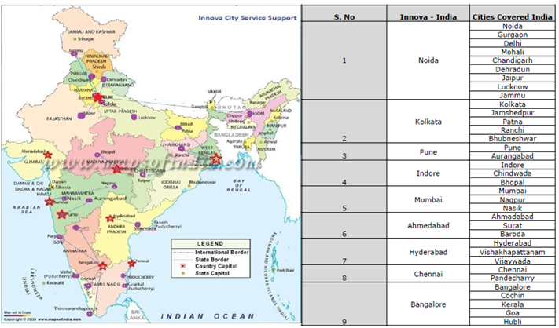
INNOVA Presence
www.innovacommunications.com

Slide 7
Our Client Base & Services Offered.
www.innovacommunications.com

Slide 8
Edu-Tech
Edu-Tech
Planet Edu collaboration with Zamit , which provides one stop solution for school eco system.
Outbound calls to schools for free sign up with Zamit.
Handled Inbound queries for schools regarding the application.
Sales & onboarding process.
Provide Voice, Chat and Email support
Handled Inbound Queries of Various Courses.
Outbound calls for routing walk-ins to centers and Colleges
Provide Voice, Chat and Email support
Sales & Onboarding Process
Educate customer flip learn online store
www.innovacommunications.com

Slide 9
Telecom
Close Looping Process
Compliant & Request
GPRS,DND,Redex,Delhi Express,
Payment Updation,Blackberry Process,
Delhi Roaming Coordinator.
Provisioning & Exception.
Nodal Compliant.
OGM Helpdesk.
Appellate Help Desk (Inbound & Outbound).
Handling Escalation on Calls & Mail.
SME/Enterprise Process.
Prepaid Verification Process.
Retention Onboarding Process.
Advance Rental Calling.
HVC Retention Process.
Prepaid MNP Process.
Upselling Calling
NPD Calling
CPM (Churn Propensity Module)
Inbound for High Value customers
Displacement Calling
Post To Pre Retention Calling
www.innovacommunications.com

Slide 10
Telecom
Collection of Corporate & Individual customers
Individual Collection Process. Pre Due date calling zero Bucket
COCP - Corporate Collection Calling.
Field collection support for high value platinum customers.
Welcome Onboarding.
Credit Limit and Sales Calling.
Tele-Sales Mobile Services.
P2P Sales.
Vodafone Mini Store (New Acquisition of Pre paid and post paid.)
www.innovacommunications.com

Slide 11
Banking
Banking
Write off collection cases. (Consumer Durable Bajaj FinServ)
L1 Bucket cases Collection. (Consumer Durable Bajaj Finserv)
Sbi credit card write off cases.
Finding other various ways for customer details for follow up and payment clearance.
Skip tracing with available resources
Rigorous follow ups
Collection calls to the customer
Citi Bank personal loan write off cases.
Skip Tracing through different medias.
Coordinating with departments in case any waivers or approvals required.
STPL (Short term personal loans recovery)
www.innovacommunications.com

Slide 12
Payment Solution
Payment Solution
Managing Accounts Receivable for Pine Labs.
Regular follow up with internal departments to resolve end customers disputes.
Regular Strategy Planning basis on Past Due % in order to decrease the DSO( Days Sales Outstanding).
Skip Tracing done on Portfolio Level as per individual agent.
Meeting quality threshold which is same as Pine Labs in house team.
Collection calls to the customer related to Bad Debt of Pay Day loan which is provided to them on there salary basis.
Skip Tracing through different medias.
Escalation Management.
Field call closure, Service Request, Case management .
www.innovacommunications.com

Slide 13
Lead Generation
Franchisee Sale
Au Naturle is a concept wherein they have fully automated Roller Icre cream machine which makes the truly natural Ice Cream in front of customers.
Its an outbound Franchise sales process wherein we calls the customer as per there enquiry which they raise on social sites or website of Au Natrule.
We share the Franchise details with customers via call/email/whatsapp as per there call and convert the lead in to deal.
Lead Generation
Identified the right person from IT/Procurement department after doing hunting on these accounts.
The process is stimulating and capturing interest in a product or service for the purpose of developing sales pipeline,
Generate the lead and assign to concern Account Manager by TRM for the demonstration of the products.
www.innovacommunications.com

Slide 14
E-Commerce
E-Commerce
Feed Back Calling
Retention.
Upselling
Educate calling.
Survey Calling
Chat Process.
Voice based input support.
Lead-generation.
Query, Requests & complaint calls
Order status, Order Tracking.
Returns Logistics refund processing
Voice based Outbound lead generation
Query, request & Complaint calls
www.innovacommunications.com

Slide 15
Loyalty Program
Loyalty Program
Outbound calls for capturing painters & contractors details & enhance the base.
To educate them about Promotional Scheme, Coupon Code, Bonus point scheme.
To create awareness of Sakarni product among Painters.
Outbound calls to provide resolutions of painters complaints,.
Outbound calls for feedback according to the complain & about the products.
Inbound desk would be helpful for painters, provide on the spot resolution for their query.
Through an outbound call, if a company wants to do R&D on a particular product then we can take suggestion from painters & contractors as well.
To create awareness of KEI product among Electricians.
Outbound calls to provide resolutions of electricians complaints,.
Inbound desk would be helpful for electricians, provide on the spot resolution for their query.
Through an outbound call, if a company wants to do R&D on a particular product then we can take suggestion from electricians as well.
Outbound calls for capturing electricians details & enhance the base.
To educate them about Promotional Scheme, Coupon Code, Bonus point scheme.

Slide 16
Energy
Energy
Inbound calls for register complaints and inquiry about products.
Lead generation for new product purchase.
Outbound calls for feedback according to the complaint.
Outbound calling according AMC for lead generation about warranty extend.
Outbound calling at Sales Leads to connect to customer with the nearest Dealer/Distributor for the new product purchase.
Up sale about new products and warranty extend (AMC) on inbound calls.
Outbound calls for feedback according to the complaint.
Outbound calls for capturing electricians details &enhance the base.
To educate them about Promotional Scheme, Coupon Code, Bonus point scheme.
To create awareness of KEI product among Electricians.
Outbound calls to provide resolutions of electricians complaints,.
Outbound calls for feedback according to the complain & about the products.
Inbound desk would be helpful for electricians, provide on the spot resolution for their query.
Through an outbound call, if a company wants to do R&D on a particular product then we can take suggestion from electricians as well.
www.innovacommunications.com

Slide 17
Research & Data Entry
Thinker Education (BUKIT TIMAH PTE. LTD.)
KDK is dedicated in providing VALUE ADDED solutions in Indian Taxation Domain for Tax Professionals & Small & Medium Business.
Dedicated Inbound Support team aligned who assist the customer over the call and mail related to there compliant/query about the software.
Lead generation for new product purchase or renewal of the software.
Enter data in excel format of school assignments exams from adobe PDF documents within the time limits.
Compiling verifying accuracy and sorting questions to prepare PDF file for computer entry.
Reviewing exams for deficiencies or errors correcting any incompatibilities and checking output.
www.innovacommunications.com

Slide 18
RPO Services
USA Based IT Consulting Company
Team Strength : 270
Accounting & Payroll Management
Recruitment & On Boarding
Sales Management
Collections / AR Management
www.innovacommunications.com

Slide 19
.
We have a PAN India Level Coverage in all TR cities and having 24*7 support team for the customers.
Large in Database for the Global, MNC and Industry top Accounts
In house Software for the lead generation/Ticketing of the leads from the prospect's accounts.
From the Software we can track the lead/Purchase Order of the account/Follow up status on lead by sales team/prospects.
There are data sites with the help of it we are able to identify the B2B contacts of the companies like IT/Procurement managers/head of the department those who are the decision makers in companies.
We have trained and expertise team for lead generation towards the business prospects for the companies.
Tracking management systems of the generated leads from the creation to end of the lead closures towards the PO received in that account.
Dedicated marketing team to run the digital process on different platform which helps potential customers to contact us regarding there company requirements.
Why Innova as Lead Generation
www.innovacommunications.com

Slide 20
B2B Lead Generation Services for technology products and services for large enterprises mid market and SMB companies in India

Slide 21
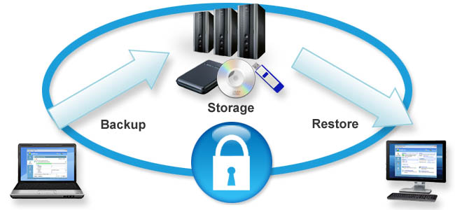
Data Security & System Configuration
San software
CMS Reporting & ACD options
Redundant core network based on Nortel chassis L3 Juniper
periphery firewalls & Symantec endpoint security
Server infrastructure from Dell, IBM & HP
Branded Laptop/desktop computers from Dell/HP
San Call Recording and Quality Monitoring
ISO 9001 & 27001 certified & compliance for Data Security
WAN connectivity over multiple
MPLS links from separate service providers.
www.innovacommunications.com

Slide 22
Data Security & System Configuration
Anti Virus Security- Quick Heal Anti Virus (Quick Heal Technologies Ltd. is an IT security solutions
Provider and an ISO 9001 certified company. The products are certified by ICSA Labs and AV-TEST)
Data Backup Security.(The purpose is to recover data after its loss, be it by data deletion or corruption. Data loss can be a common experience of computer users)
LAN Security.(port security, port filtering, and other LAN security features). certified by ICSA Labs and AV-TEST).
www.innovacommunications.com

Slide 23
Thank you.
www.innovacommunications.com

